Slide 1

Security Support in Android Platform
Nourhan jamal 20156018
Rawan khaled 20156003
Farah essam 20156019

Slide 2

Agenda..
Introduction
Linux security
The key components of the Android Security
Tips of security
Application Security
Pros & Cons of Android Phone Encryption
Atacks

Slide 3
Introduction..
Android is designed:
To Be Open
Android was designed with multi-layered security that is flexible enough to support an open platform while still protecting all users of the platform.
For Developers
Developers less familiar with security will be protected by safe defaults. In addition to providing a stable platform to build upon, Android gives additional support to developers in a number of ways.
For Users
Users are provided visibility into permissions requested by each application and control over those permissions. This design includes the expectation that attackers would attempt to perform common attacks

Slide 4
Linux security
Linux has become a stable and secure kernel trusted by many corporations and security professionals.
the Linux kernel provides Android with several key security features, including:
A user-based permissions model
Process isolation
Extensible mechanism for secure IPC
The ability to remove unnecessary and potentially insecure parts of the kernel

Slide 5

As a multiuser operating system, a fundamental security objective of the Linux kernel is to isolate user resources from one another. The Linux security philosophy is to protect user resources from one another. Thus, Linux:
Prevents user A from reading user B's files
Ensures that user A does not exhaust user B's memory
Ensures that user A does not exhaust user B's CPU resources
Ensures that user A does not exhaust user B's devices (e.g. telephony, GPS, Bluetooth)

Slide 6
Security Tips..
The following core security features help you build secure apps:
The Android Application Sandbox, which isolates your app data and code execution from other apps.
An application framework with robust implementations of common security functionality such as cryptography, permissions and secure IPC.
An encrypted file system that can be enabled to protect data on lost or stolen devices.

Slide 7
Application Sandbox
The Android platform takes advantage of the Linux user-based protection to identify and isolate app resources.
This isolates apps from each other and protects apps and the system from malicious apps.
To do this, Android assigns a unique user ID (UID) to each Android application and runs it in its own process.
Because the Application Sandbox is in the kernel, this security model extends to native code and to operating system applications.
Notes:
All of the software above the kernel, such as operating system libraries, application framework, application runtime, and all applications, run within the Application Sandbox

Slide 8
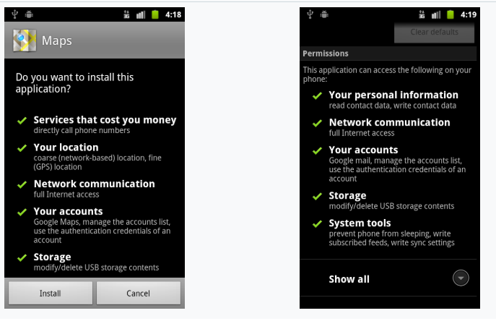
Permission:
Whitelist model
Allow minimal access by default
User accepted access
Ask users fewer questions
Make questions more understandable
Cryptography:
is associated with the process of converting ordinary plain text into unintelligible text and vice-versa.
It is a method of storing and transmitting data in a particular form .
not only protects data from theft or alteration, but can also be used for user authentication

Slide 9
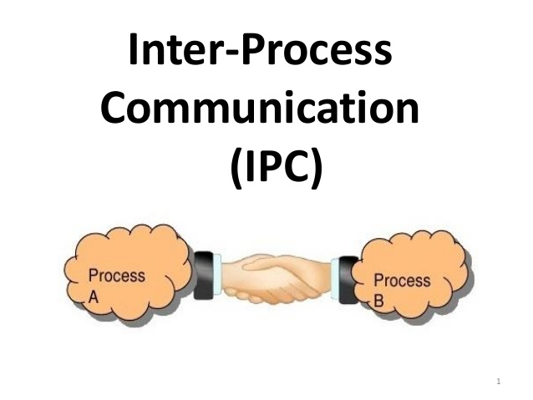
IPC : Inter process Communication
In software systems it is often the case that different processes need to communicate with one another in order to cooperate on some task.
The Android IPC mechanisms are designed to operate at the level of components rather than processes.
In other words a component in one app may use IPC to communicate with a component in another app, or with another component in the same app.

Slide 10
Difference between encryption and cryptology?
Earlier cryptography was effectively synonymous with encryption but nowadays cryptography is mainly based on mathematical theory and computer science practice.

Slide 11
Pros of Android Phone Encryption
So, firstly we are now going to check what are the advantages of having encrypted Android phone.
It is very easy to do
Do not have to install any extra app
App data also get encrypted
Data Security Increases
Secure your phone from being retrieved

Slide 12
Cons of Android Phone Encryption
Not available on every Android phone
It cannot be done using any app
It’s a very lengthy taking process
It cannot be revered
Decreases your phone performance

Slide 13
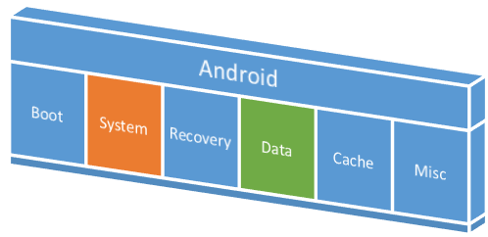
System Partition and Safe Mode
The system partition contains Android's kernel as well as the operating system libraries, application runtime, application framework, and applications. This partition is set to read-only. When a user boots the device into Safe Mode, third-party applications may be launched manually by the device owner but are not launched by default.

Slide 14
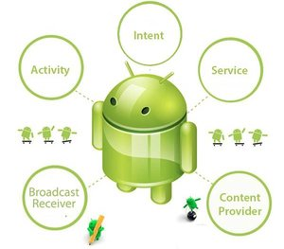
Application security
The main Android application building blocks are:
AndroidManifest.xml : file is the control file that tells the system what to do with all the top-level components in an application.
Activities : The code for a single, user-focused task.
Services : a body of code that runs in the background.
Broadcast Receiver : is an object that is instantiated when an IPC mechanism known as an Intent is issued by the operating system or another application.
Notes:
AndroidManifest.xml: The AndroidManifest.xml file is the control file that tells the system what to do with all the top-level components (specifically activities, services, broadcast receivers, and content providers described below) in an application. This also specifies which permissions are required.
Activities: An Activity is, generally, the code for a single, user-focused task. It usually includes displaying a UI to the user, but it does not have to -- some Activities never display UIs. Typically, one of the application's Activities is the entry point to an application.
Services: A Service is a body of code that runs in the background. It can run in its own process, or in the context of another application's process. Other components "bind" to a Service and invoke methods on it via remote procedure calls. An example of a Service is a media player: even when the user quits the media-selection UI, the user probably still intends for music to keep playing. A Service keeps the music going even when the UI has completed.
Broadcast Receiver: A BroadcastReceiver is an object that is instantiated when an IPC mechanism known as an Intent is issued by the operating system or another application. An application may register a receiver for the low battery message, for example, and change its behavior based on that information.

Slide 15
The Android Permission Model: Accessing Protected APIs
Capabilities are restricted by :
-An intentional lack of APIs to the sensitive functionality .
-Separation of roles provides a security measure, as with the per-application isolation of storage.
-the sensitive APIs are intended for use by trusted applications and protected through a security mechanism known as Permissions.
protected APIs include:
Camera functions
Location data (GPS)
Bluetooth functions
Telephony functions
SMS/MMS functions
Network/data connections

Slide 16
Cost-Sensitive APIs
A cost sensitive API is any function that might generate a cost for the user or the network. The Android platform has placed cost sensitive APIs in the list of protected APIs controlled by the OS.
These APIs include:
Telephony
SMS/MMS
Network/Data
In-App Billing
SIM Card Access :
Low level access to the SIM card is not available to third-party apps. The OS handles all communications with the SIM card including access to personal information (contacts) on the SIM card memory. Applications also cannot access AT commands, as these are managed exclusively by the Radio Interface Layer (RIL).

Slide 17
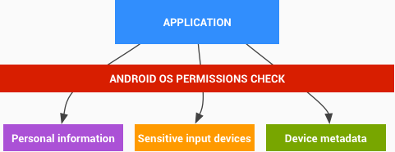
Personal Information
Sensitive Data Input Devices
Android devices frequently provide sensitive data input devices that allow applications to interact with the surrounding environment, such as camera, microphone or GPS. For a third-party application to access these devices, it must first be explicitly provided access by the user through the use of Android OS Permissions
Device Metadata
Android also strives to restrict access to data that is not intrinsically sensitive, but may indirectly reveal characteristics about the user, user preferences, and the manner in which they use a device.
Notes:
Data mohema bas mesh btb2a sensitive zai eli bist5dmoha fel mo5brat 3lshan tgeb info 3n el user deh el meta data

Slide 18
Attacks…
Attacks can be classified into two types :
1 – Passive (For Reconnaissance)
2 – Active (For Exploitation)
Examples :
1 – Remote Access Trojans
2 – Network attack
3 – Malicious file attack
4 – Root Permissions

Slide 19
1-Remote Access Trojan
Enables remote administrative control for Reconnaissance and attack.
Monitor user behavior through key loggers and spywares.
Activate webcam and record audio.
Format drives
Obtain access / login information of the victim.
Notes:
ack Orifice is a computer program designed for remote system administration. It enables a user to control a computer running the Microsoft Windows operating system from a remote location

Slide 20
2-Network Attack :
Occurs when an android device is connected to wifi or a malicious hotspot
3-Malicious File Attack:
Is a piece of code that is execute behind the scenes as an “Exploit” to some vulnerabilities in the victim’s system.
This allows attackers to perform Remote code execution
-Such as : patches , fake links , encrypted text files and Fake images.

Slide 21
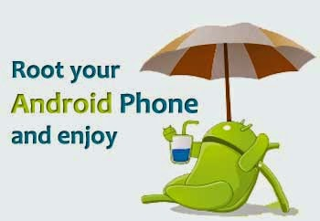
Rooting of Devices
on Android only the kernel and a small subset of the core applications run with root permissions. Android does not prevent a user or application with root permissions from modifying the operating system, kernel, or any other application.
In general, root has full access to all applications and all application data.
Users that change the permissions on an Android device to grant root access to applications increase the security exposure to malicious applications and potential application flaws.
Notes:
- Attacks that aim to obtain password of the root user of the operating system which gives permissions to access sensitive data, root configurations and take full control on the system.
- All the previous attacks can be used to serve this purpose.

Slide 22


Slide 23
Reference
https://source.android.com/security/overview/app-security
https://developer.android.com/training/articles/security-tips
https://whatis.techtarget.com/definition/active-reconnaissance

